Slide 1
First.name Last.name Department Name Proposed Promotion/Appointment Level Double Promotion (if applicable) Mentor(s): First Last
Education
Year | PhD, Computer Science | Berkeley
Year | SB, Mathematics | MIT
Professional Positions
2015 to present | Assistant Professor | MIT
2013 to 2015 | Postdoctoral Researcher | Stanford
Year1 to Year2 | Position | Institution
Notes:
Please include an image that is representative of the candidate’s research on this slide and provide a couple of sentences explaining the image’s significance here.

Slide 2
Research Area: Astrophysics
Main goal: Understanding the nature of dark matter
Background and context
Give background and context
Dark matter comprise 95% of the mass in the Universe
We don’t know what it is
Cosmic tomatoes are a leading candidate
Tools and methods
Xray telescope in space: Xtra (Xray Telescope )
Gravitational detectors: BGWOE (Best Gravitational Wave Detector Ever)
Direct detection in the lab

Slide 3
Research Highlights
Main question: Is dark matter made up of cosmic tomatoes?
Evidence for cosmic tomatoes in galactic center [research highlight 1]
Spinning cosmic tomatoes easily torn apart due to their seedy fluid centers
Observed Xray observations correlated with gravitational waves from tomato stars
First indirect evidence that cosmic tomatoes could account for dark matter
Eliminated chocolate stars comprising of dark matter [research highlight 2]
Chocolate stars should give off copious Xray emission due to their highly caloric cores
Low Xray flux not consistent with chocolate stars
Showed that cosmic tomatoes cannot coexist with chocolate stars

Slide 4
Research Presentation (15-20 minutes)
Give an explanation of 1 or 2 major contributions with enough detail so that we learn some new science and why it is important/exciting.

Slide 5
Research Summary
List any other major results in addition to the 1 or 2 that were highlighted in the preceding section
Future prospects: what might we expect in the coming years?

Slide 6
Honors and Awards
List 3 to 5 of the candidates most prestigious honors and awards with dates in the following format, in reverse chronological order:
2021 | Whiz Prize
2020 | Packard Fellowship
2018 | Sloan Fellowship
Year | Award
Notes:
List Honors in reverse chronological order

Slide 7
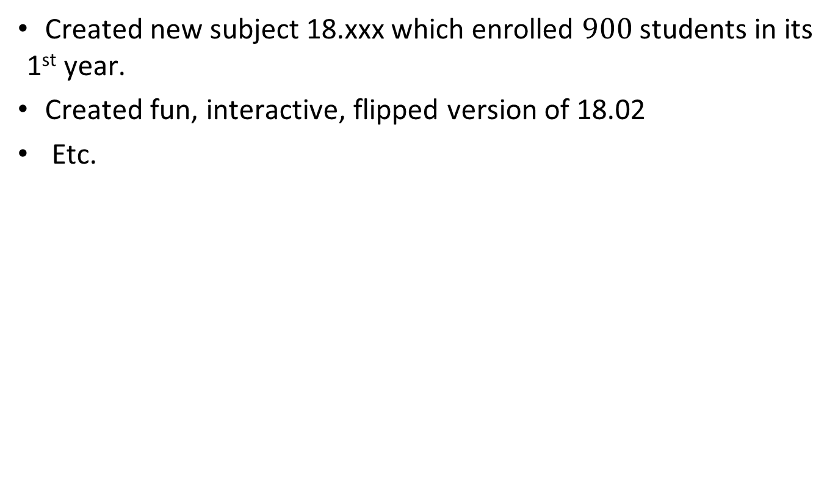
Educational Contribution Narrative
Created new subject 18.xxx which enrolled $900$ students in its 1st year.
Created fun, interactive, flipped version of 18.02
Etc.
Notes:
Outside senior hires : teaching information & narrative on teaching - references.

Slide 8
Teaching evaluations
Course Number | Course Title | Term | Role | Course Type | # Students Registered | # Survey Responses | Instructor's Evaluation | Course Evaluation
5.60 U | Thermodynamics and Kinetics | ST17 | Co-Inst. | Lecture | 26 | 11 | 6.0 | 4.5
 |  | ST16 | Co-Inst. | Lecture | 29 | 14 | 6.2 | 5.2
5.70 G | Statistical Thermodynamics | FT16 | Co-Inst. | Lecture | 20 | 16 | 6.6 | 5.8
 |  | FT15 | Co-Inst. | Lecture | 16 | 12 | 5.9 | 5.3
 |  | FT14 | Instructor | Lecture | 16 | 14 | 4.6 | 4.7
 |  | FT13 | Co-Inst. | Lecture | 15 | 7 | 4.7 | 4.4
18.904 U | Seminar in Topology | ST21 | Lecturer | Lecture | 7 | 5 | No evaluation due to pandemic | to the pandemic
Notes:
By course, reverse chronological, without leaves of any type. Please note the example of how unrated courses during covid should be noted.
Note the instructor evaluation should be bold, font size 14, and green!

Slide 9
Mentoring Summary
Trainees | Number
Undergraduate theses | 10
UROP students | 10
Graduate students | 10
Postdoctoral researchers | 10

Slide 10
Mentoring – Undergraduate students
Name | Years | Current position | Current institution
Whiz Kid | 2019 to present | Graduate student | Princeton
Chloe Clever | 2018 to 2019 | Research associate | Successful Startup, Inc
Name | 2018 to 2019
Notes:
Current mentees should be listed first, reverse chronological order

Slide 11
Mentoring – Graduate students
Name | Years | Current position | Current institution
Chloe Clever | 2016 to present
Whiz Kid | 2015 to 2020 | Postdoctoral researcher | Caltech
Mickey Mouse | 2015 to 2019 | Assistant Professor | Caltech
Notes:
Please include both the year the appointment starts and ends. Current mentees should be listed first, reverse chronological order

Slide 12
Mentoring – Postdocs
Name | Years | Current position | Current institution
John Jacob | 2020 to present
Whiz Kid | 2018 to 2020 | Assistant Professor | UC Berkeley
Chloe Clever | 2016 to 2019 | Research director | Hughes Research Labs
Name
Notes:
Please include both the year the appointment starts and ends. Current mentees should be listed first, reverse chronological order

Slide 13
Mentoring evaluation
Overall strengths:
Confidential quotations
Areas for improvement:
Confidential quotations

Slide 14
Internal Service
Role | Organization | Year
International Organizing Committee |  | 2018
Year |  | 2017
Year |  | 2017
Notes:
Full professors: Highlight 3 most important service contributions in reverse chronological order.
Content Guidelines
Full professors: Highlight 3 most important service contributions.
DO INCLUDE:
Faculty involvement in teaching GIRs
Faculty involvement in freshman advising/mentoring and freshman seminars
Faculty involvement in committees (CUP, CoD, etc.)
Housemasters, House Fellows
Special programs in teaching/leadership (ESG, IAP events, etc.)
DO NOT INCLUDE:
Faculty involvement in reading admissions folders
Faculty involvement in orientation (freshman picnic, FPOP)
Faculty involvement in commencement
UROP supervision (this goes in Mentoring) and IAP activities

Slide 15
External Service
Role | Organization | Year
Scientific Organizing Committee | International Conference on Dark Matter | 2020
Convenor | Major Dark Matter experiment | 2017
Executive committee, member | American Physical Society | 2016
Notes:
Reverse chronological order

Slide 16
External Letter Writers for AWOT & AWIT
External reviewers for AWOT case | External reviewers for AWIT case
Darwin, Charles | Curie, Marie
Einstein, Albert | Einstein, Albert
Notes:
For AWIT cases only!!!
Please list all external letter writers for previous AWOT review, along with all external letter writers for the current AWIT case.
Discuss any external reviewers solicited for feedback during AWOT review, who were not contacted for AWIT review.

Slide 17
Quotes from External Letters
Albert Einstein Institute for Advanced Study | …relatively good... …a quantum jump better than me.
Marie Curie University of Paris | …radiates intelligence and creativity. Promote her to tenure now.
Isaac Newton Cambridge University | …well on track for tenure soon. Cambridge is trying to hire her, and I expect she will find their offer to be very attractive.
Jocelyn Bell Burney | Not generous in giving credit to others.
Notes:
Positive highlights in green.
Negative comments in red.

Slide 18
Potential Concerns
3 missing external letters. Lakadazer – no reason Blanker – no response Mxyzptlk – retired. “...is a young super biologist…”
Very limited mentoring.
Not much teaching. High evaluations in two classes so far.
Notes:
15 total sought

Slide 19
Feedback to the Candidate for AWOT cases
Concern that research impact has been limited.
Focus on fewer, more impactful projects.
Teaching reviews are somewhat low.
We can provide you with resources to improve.
Etc.
Notes:
For AWOT cases only!
Bulleted list of feedback related to research, teaching, and service (not word crafted).

Slide 20
Strengths and Summary
Strengths
Brilliant and influential researcher in a very important field.
All outside letters are very strong; several say tenure now.
Active and successful mentor.
Outstanding teacher.
Good internal and external service.
Summary
XXX has made major contributions to our understanding of yyy. She’s also a superb teacher. We recommend her for promotion to Associate Professor without tenure.

Slide 21
PowerPoint Guidelines
Text/Font
Font: Calibri
Size: avoid smaller than 16pt
Avoid excessive content on a slide
Header/Footer
Change [Proposed promotion rank --- Last Name] to the name of the candidate in the Slide Master.
No additional department logos should go in the header/footer.
Charts/Graphs/Images
Resize axis labels and numbers so they are readable
Movies
When embedding movie files, make sure the movie file format is MP4
Notes
Notes for each slide should be written in 10 pt font (no larger).
Duration
Research presentation should be 15-20 minutes.

