Slide 1

Working From Home Ergonomics
Iraj Aalaei, CIH,CSP
Iraj@mit.edu

Slide 2
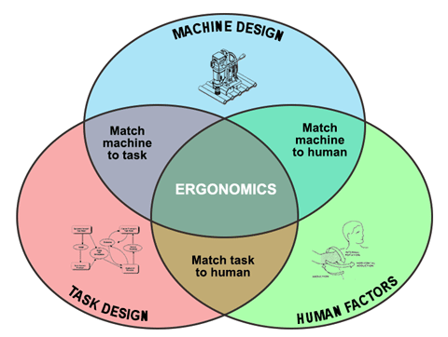
What is Ergonomics?
Ergonomics is the science of fitting the job to the worker, matching the physical requirements of the job with the physical capacity of the worker.
  Ergonomists look to modify the environment (objects, locations of objects) to fit the people who need to move them, rather than modifying people to fit the environment

Slide 3
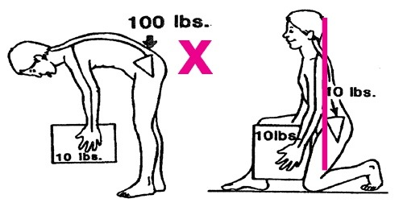
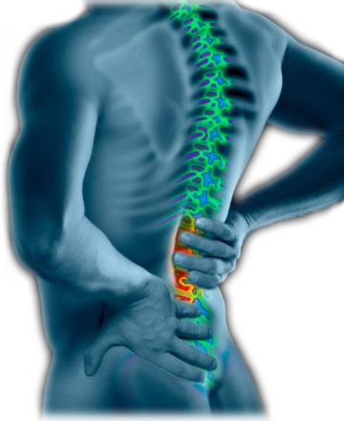
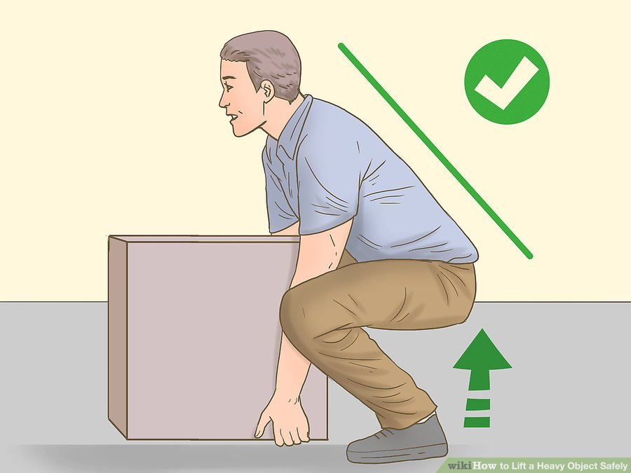
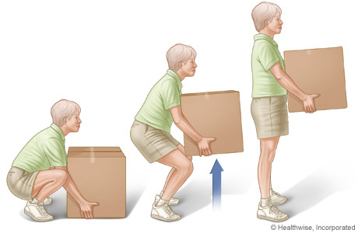
MSD occurs from repeated physical movements doing damage to tendons, nerves, muscles, and other soft body tissues resulting from the typical tasks
  30% of workplace injuries involve the back!

Slide 4
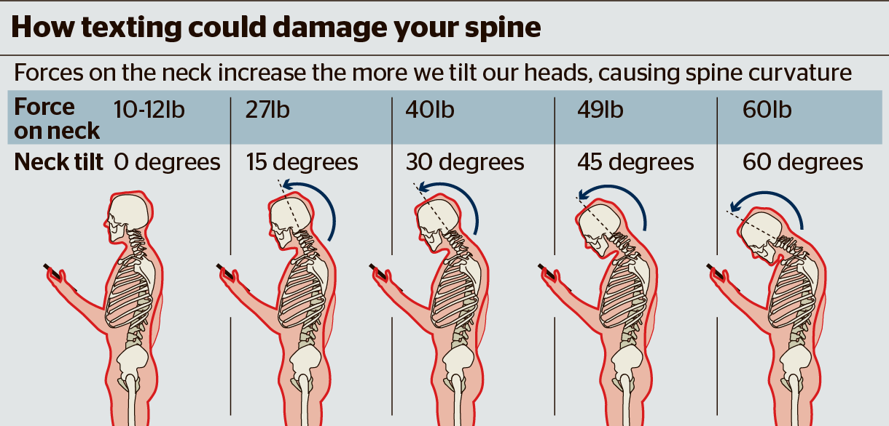
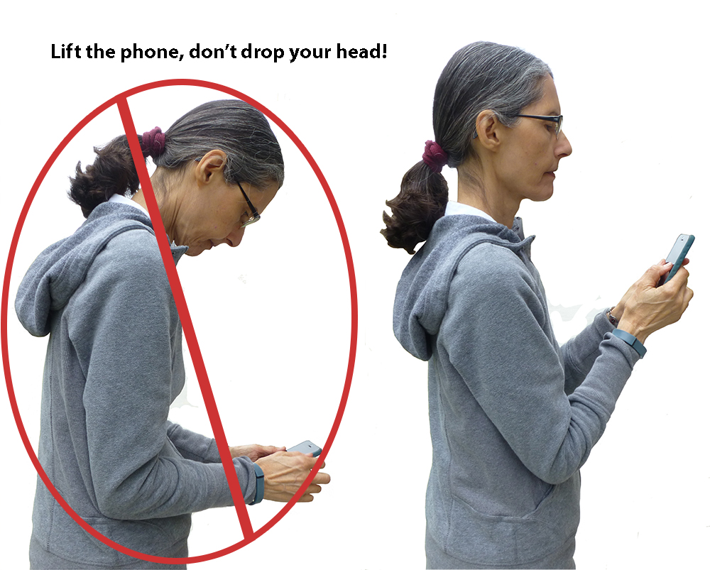
KENNETH K. HANSRAJ, MD, CHIEF OF SPINE SURGERY
NEW YORK SPINE SURGERY & REHABILITATION MEDICINE

Slide 5
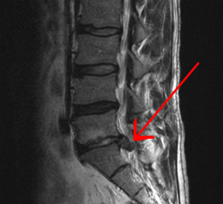
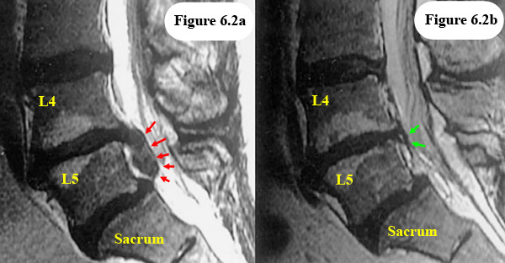
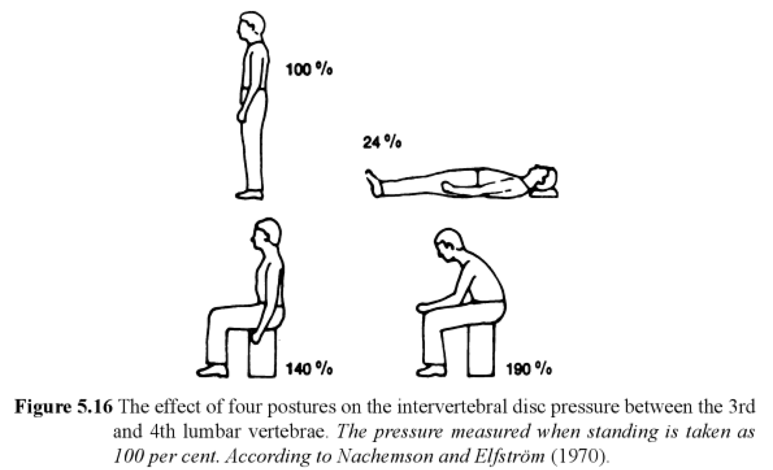
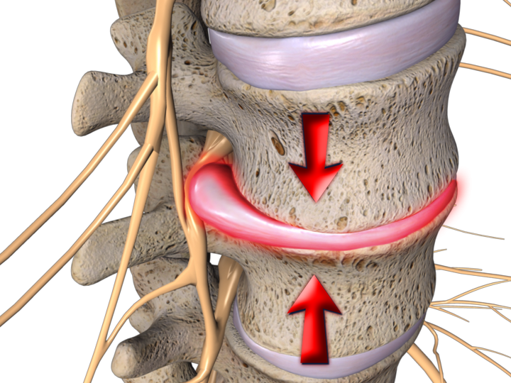
Disk Herniation/Bulging

Slide 6
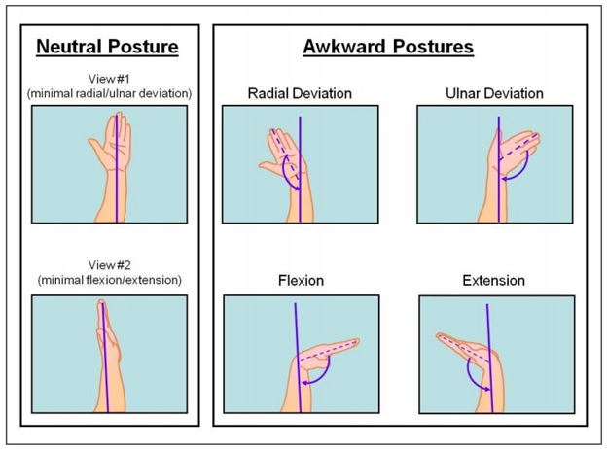
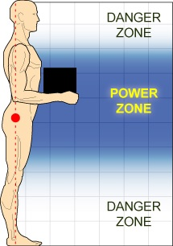
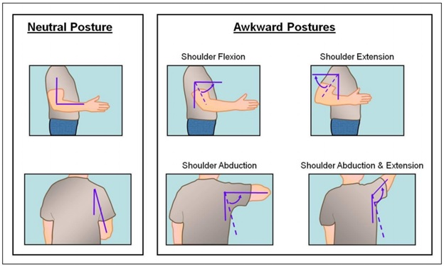
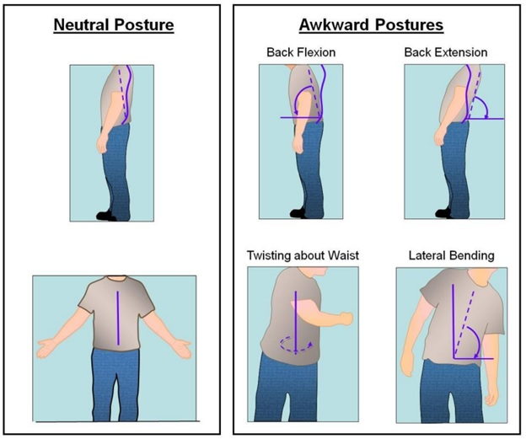
Neutral Postures
Neutral posture refers to the position of your body when it is most at rest with the minimum amount of pressure on your joints, muscles, etc.

Slide 7
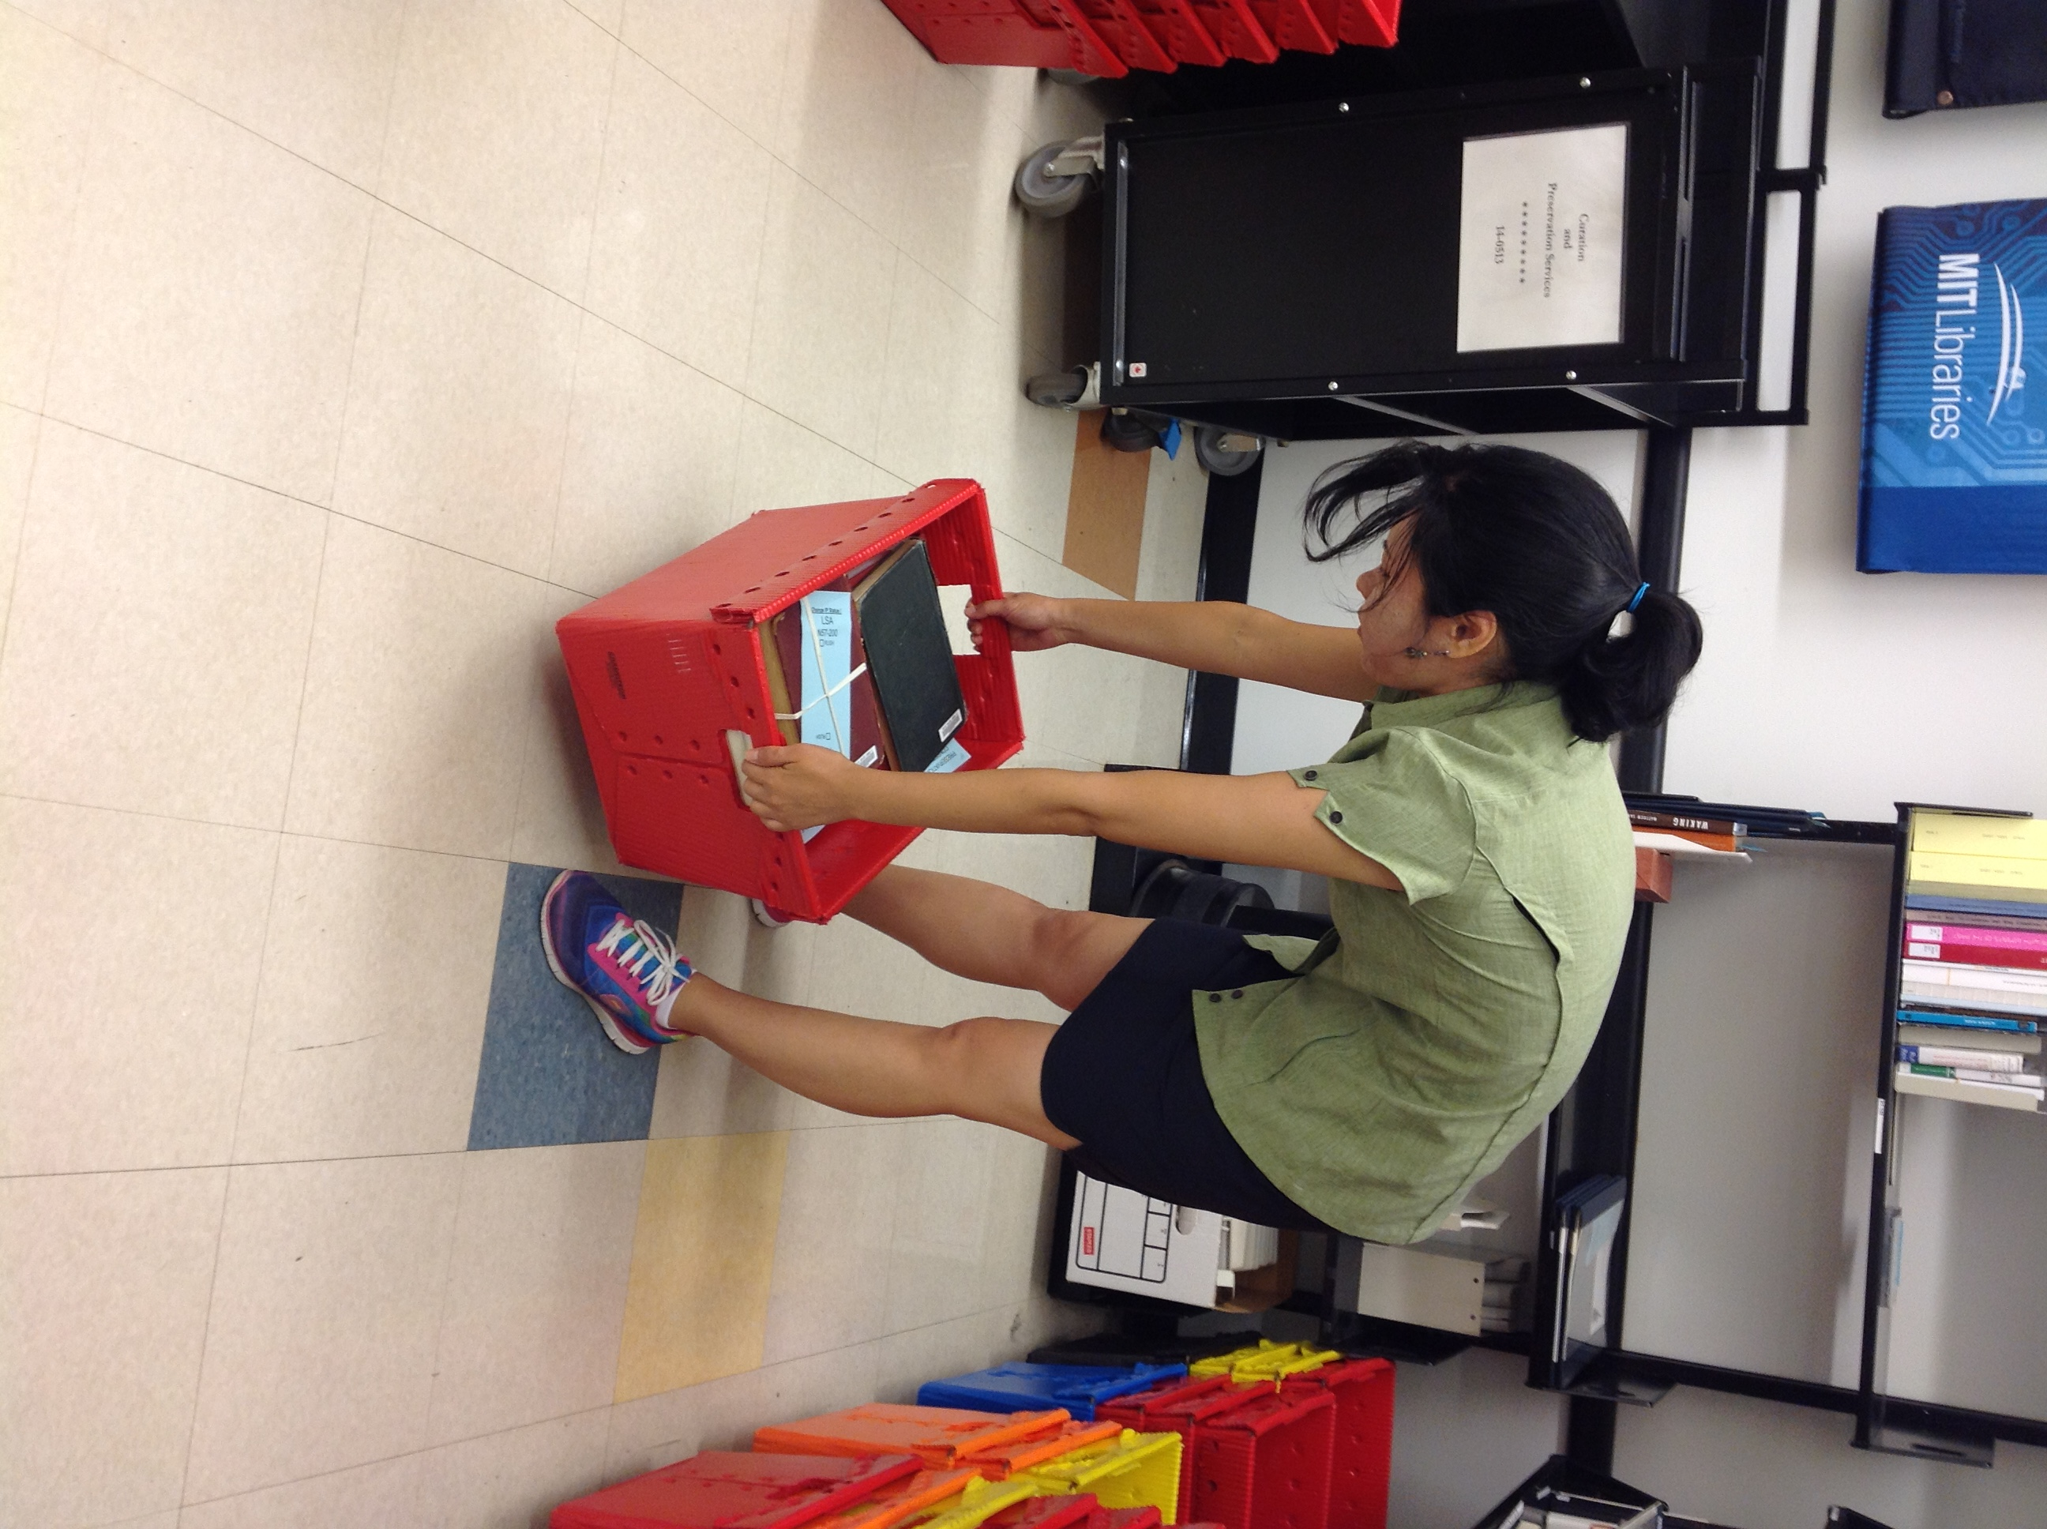
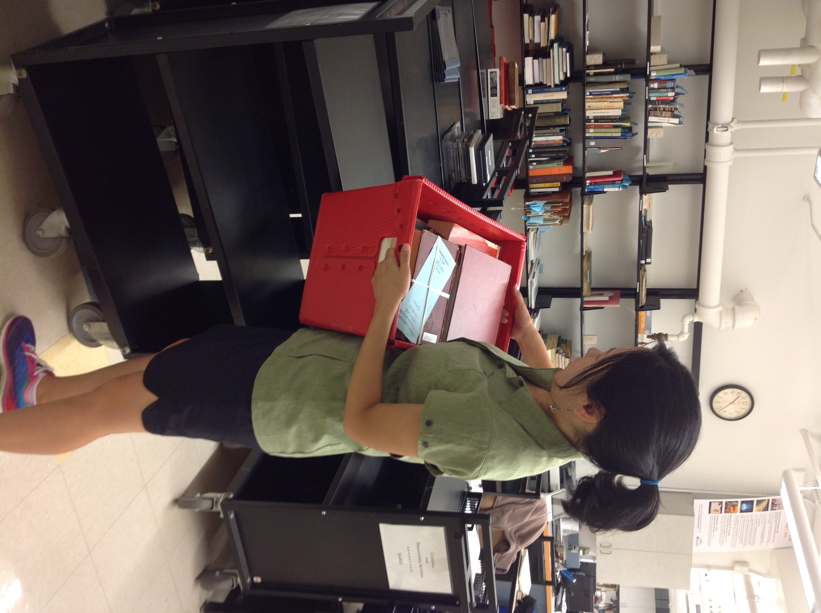
How to lift the loads?

Slide 8
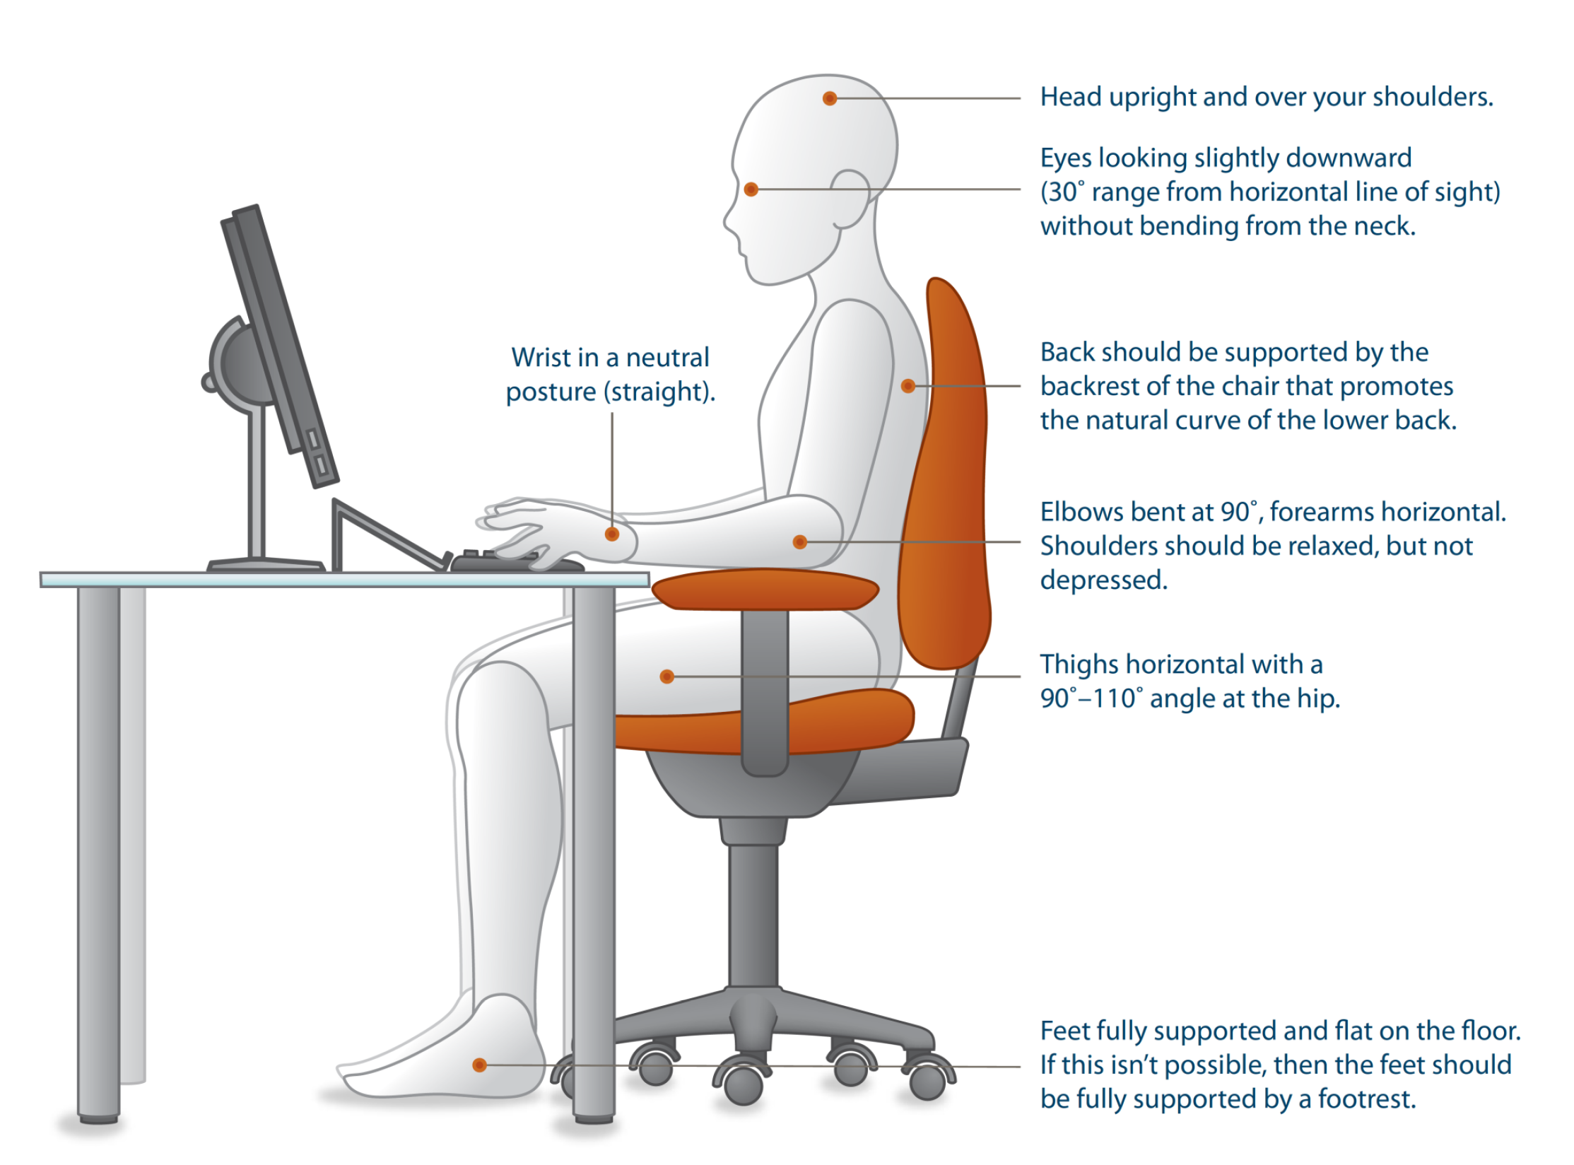
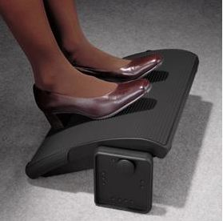
Office Ergonomics

Slide 9
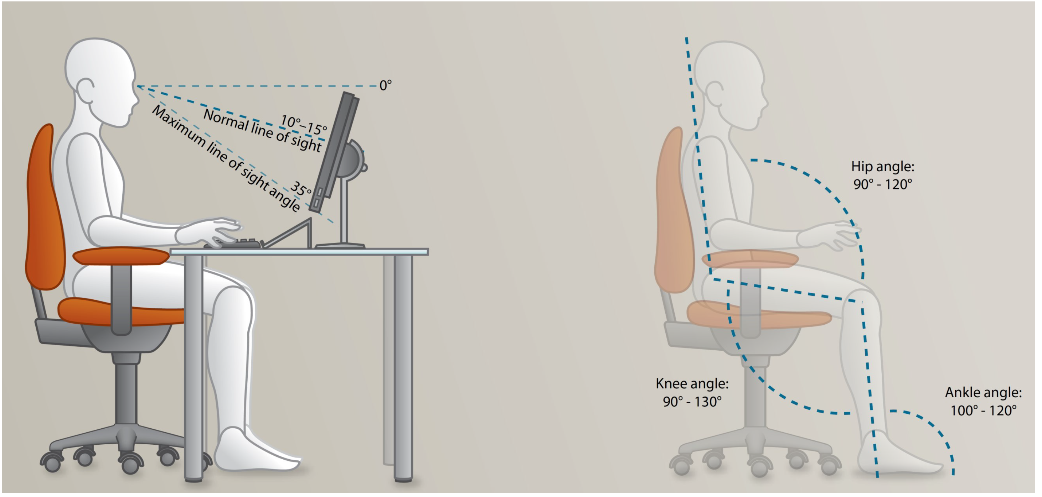
Office Ergonomics

Slide 10
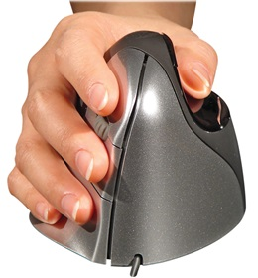
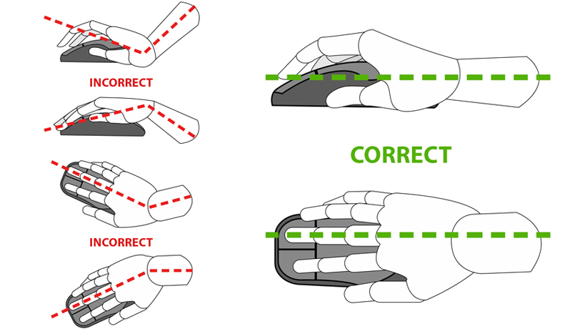
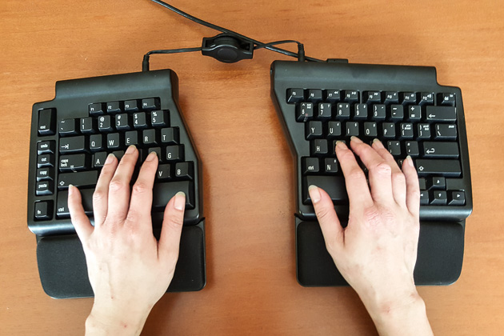
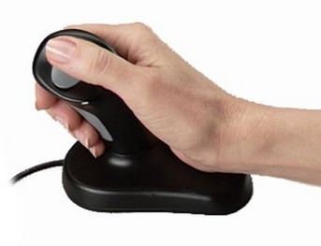
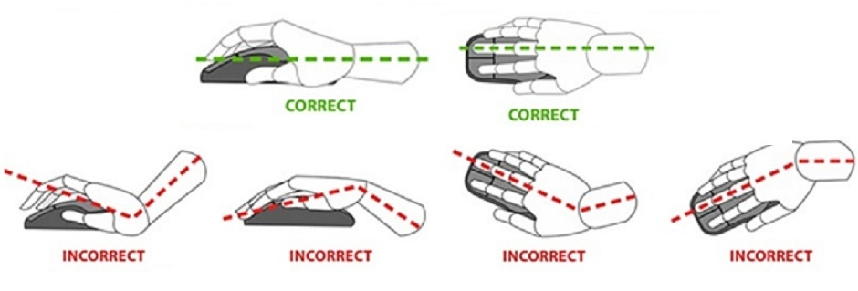
Office Ergonomics

Slide 11
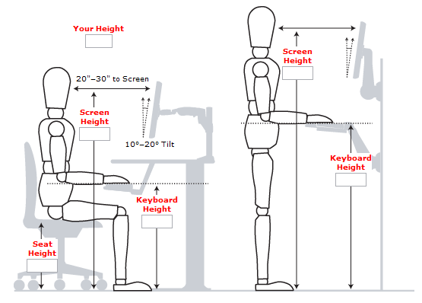
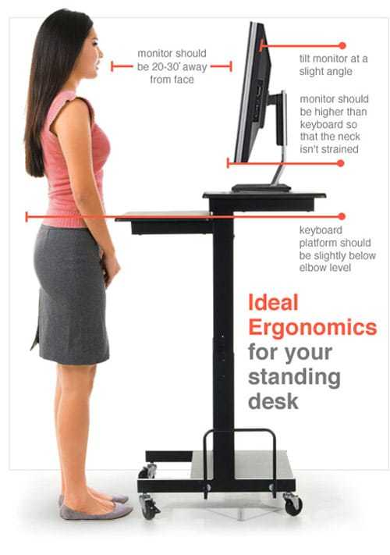
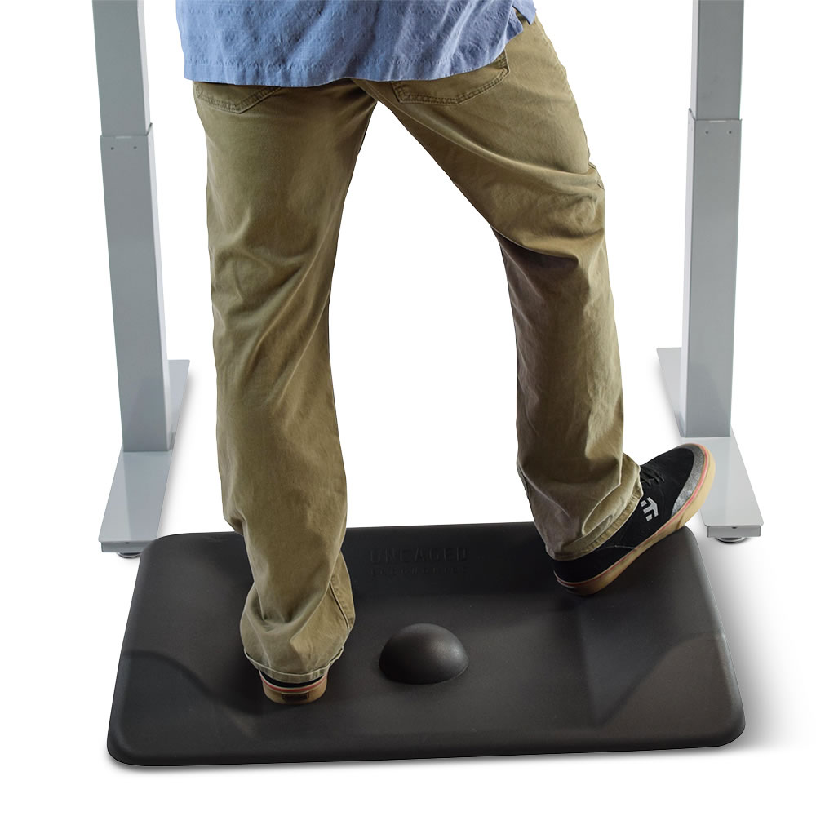
Standing Desk vs Sitting Desk

Slide 12
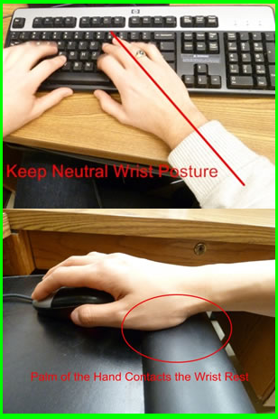
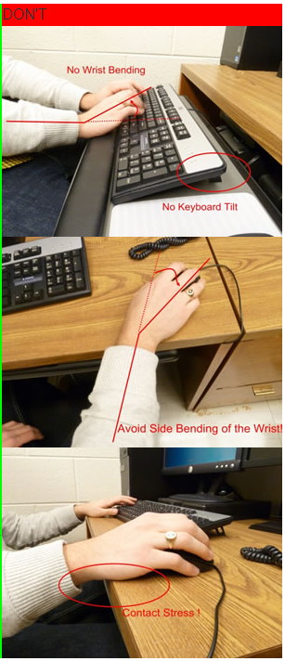

Slide 13
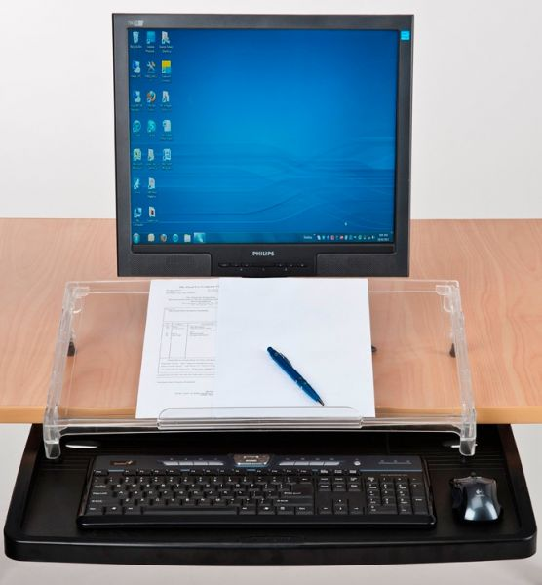
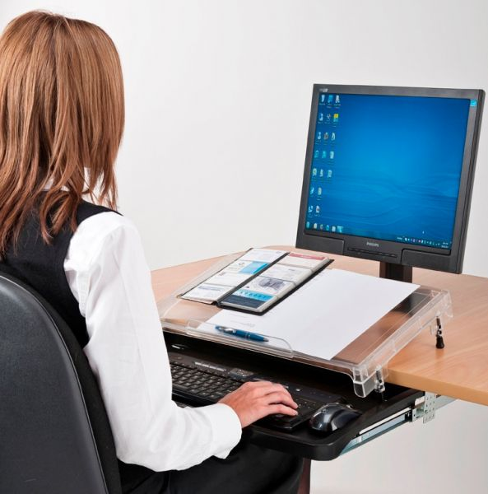

Slide 14
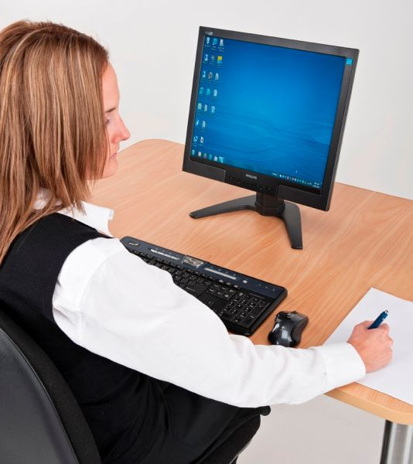
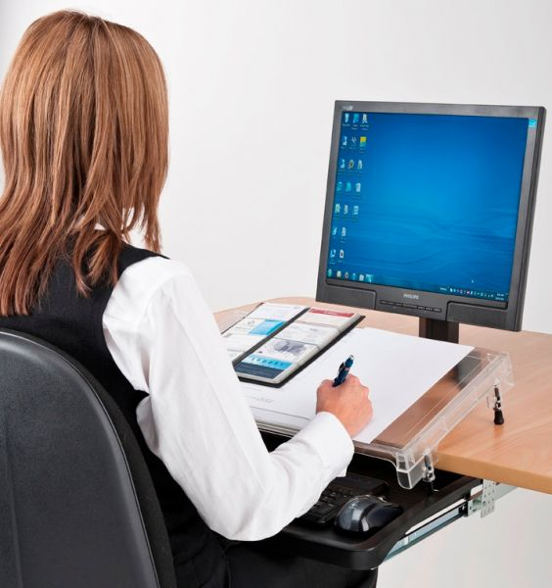
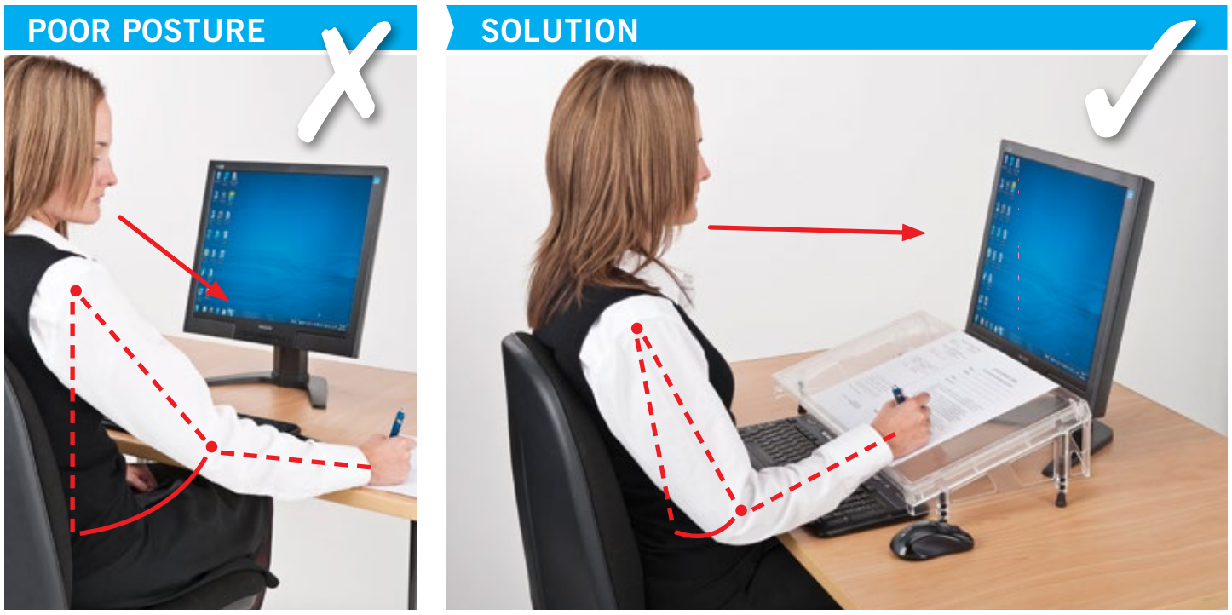

Slide 15
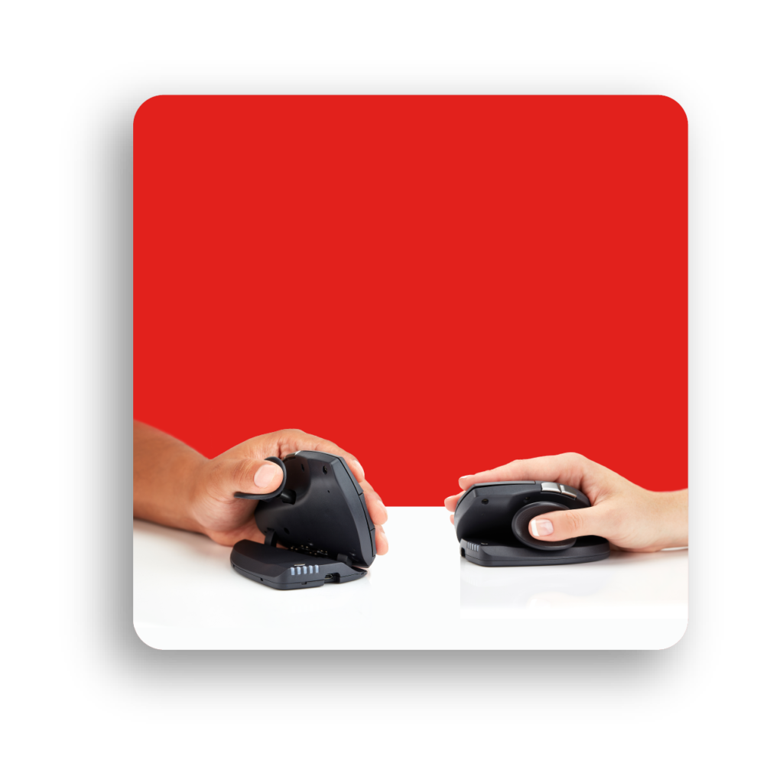
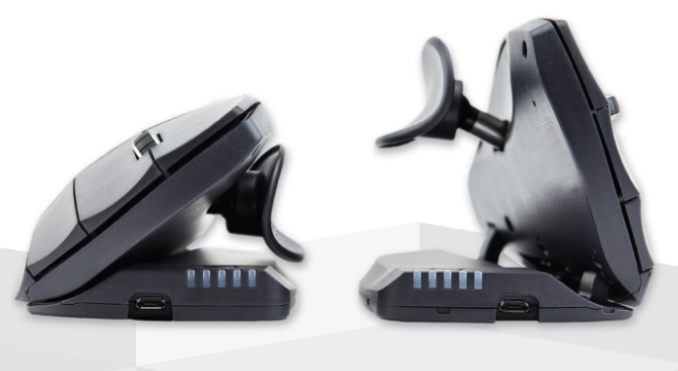
Angle Adjustment
Thumb Adjustment

Slide 16
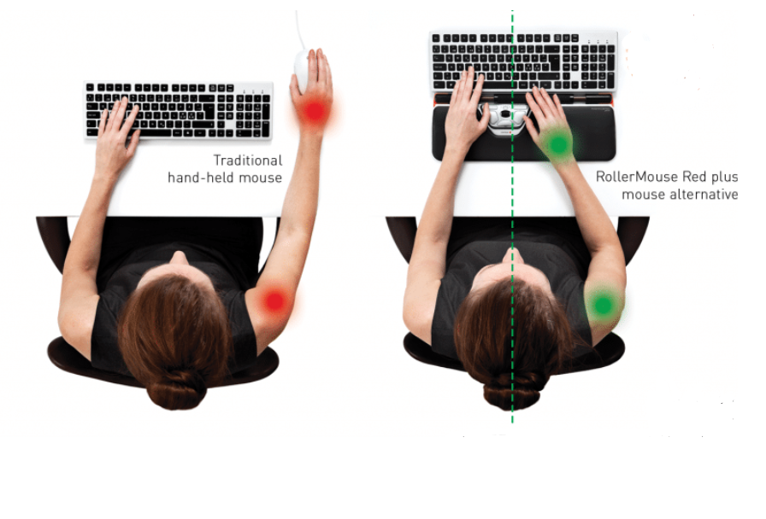
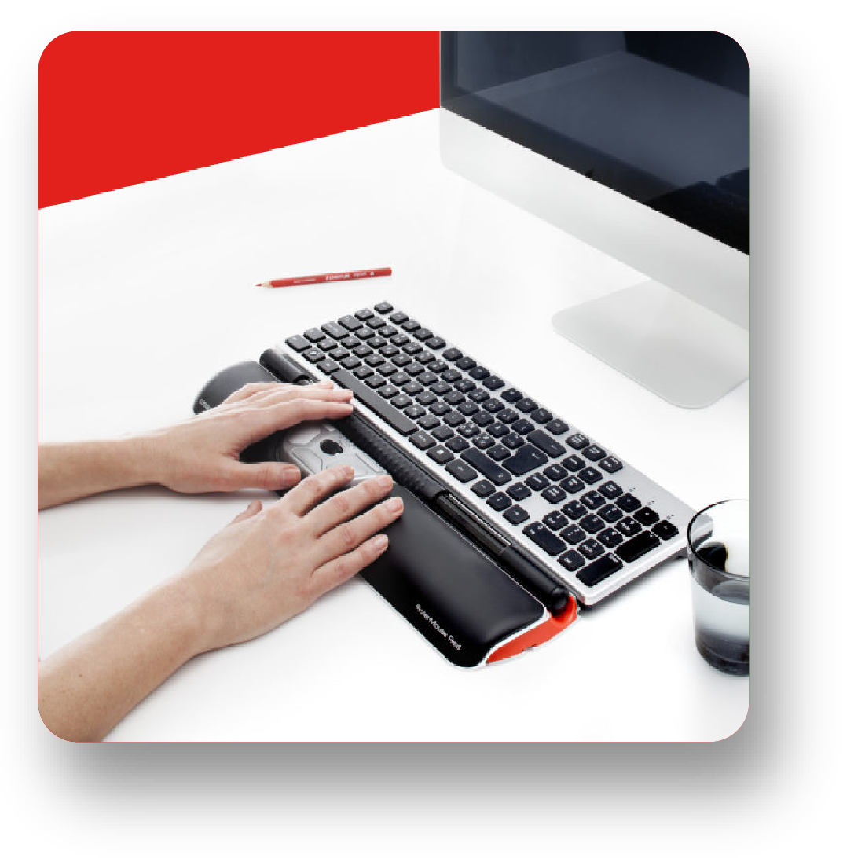
Roller Mouse

Slide 17
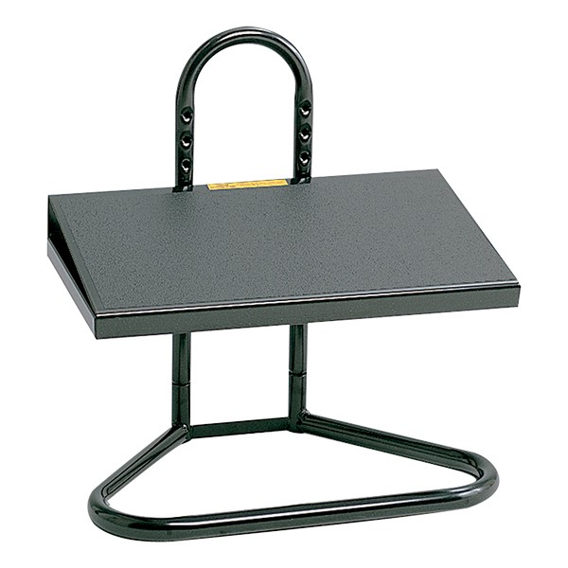
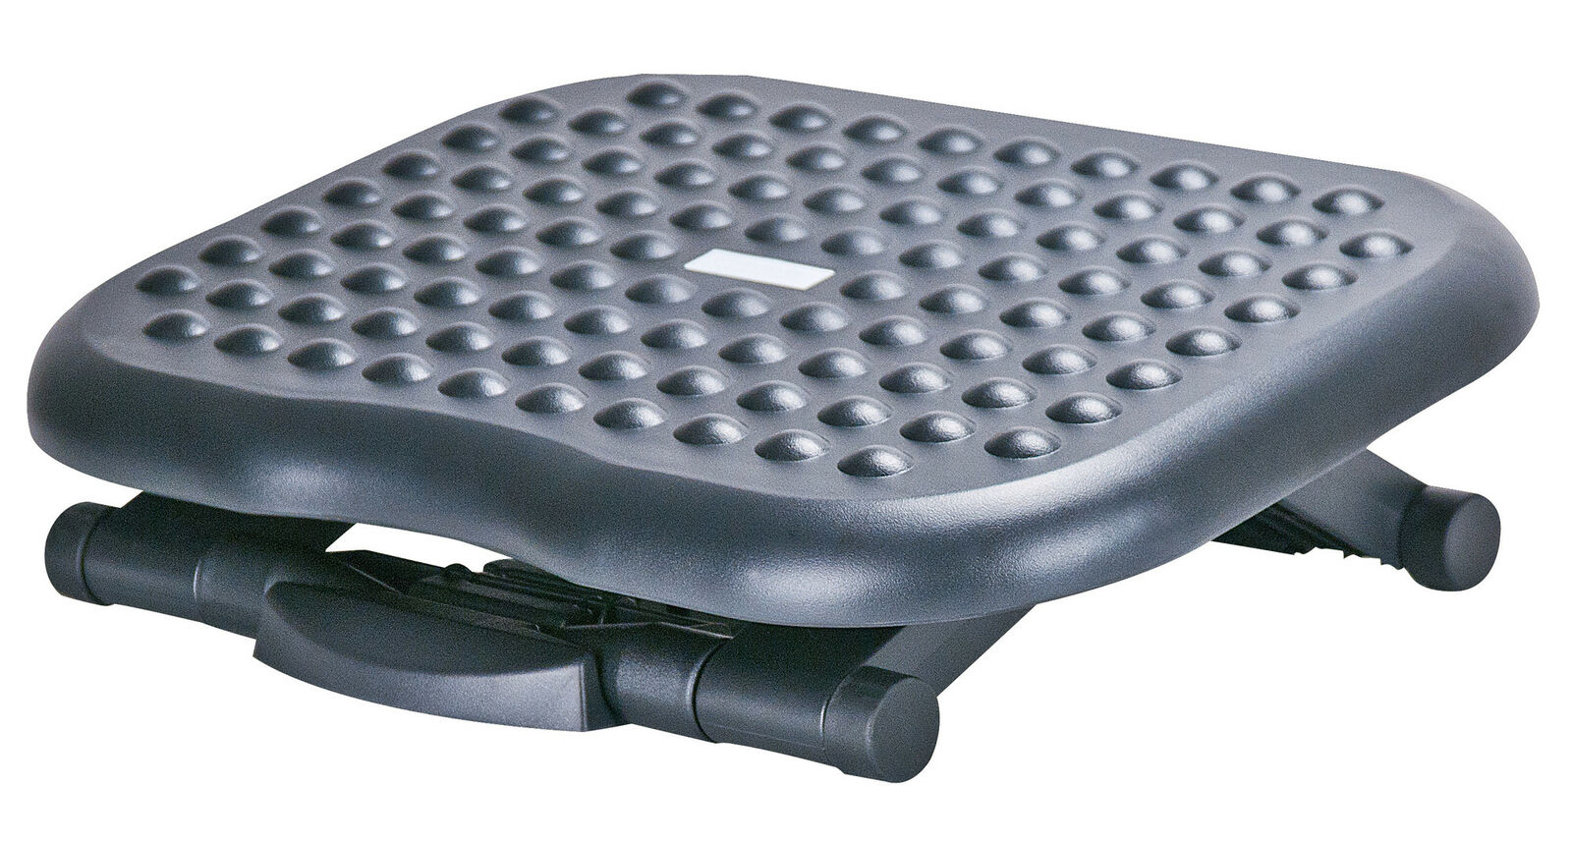
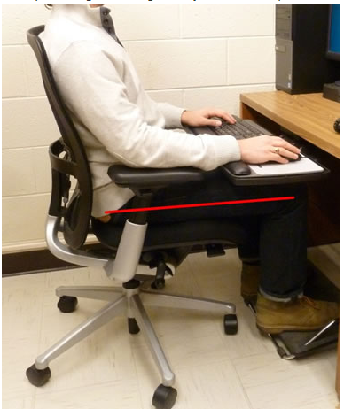
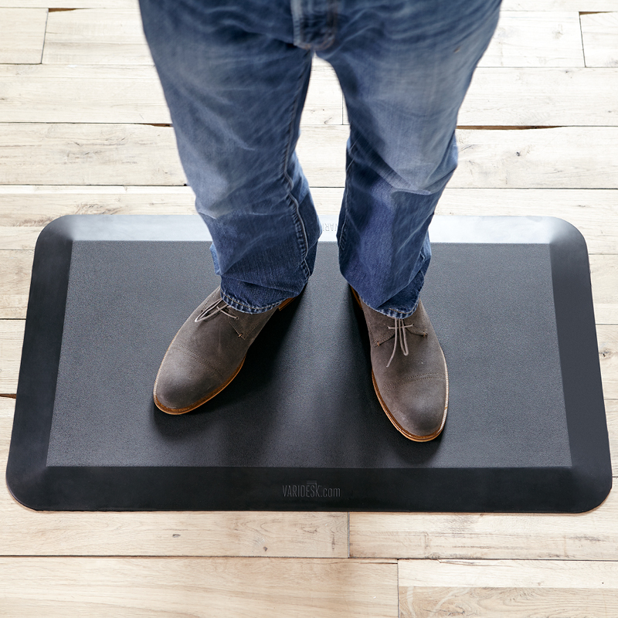

Slide 18
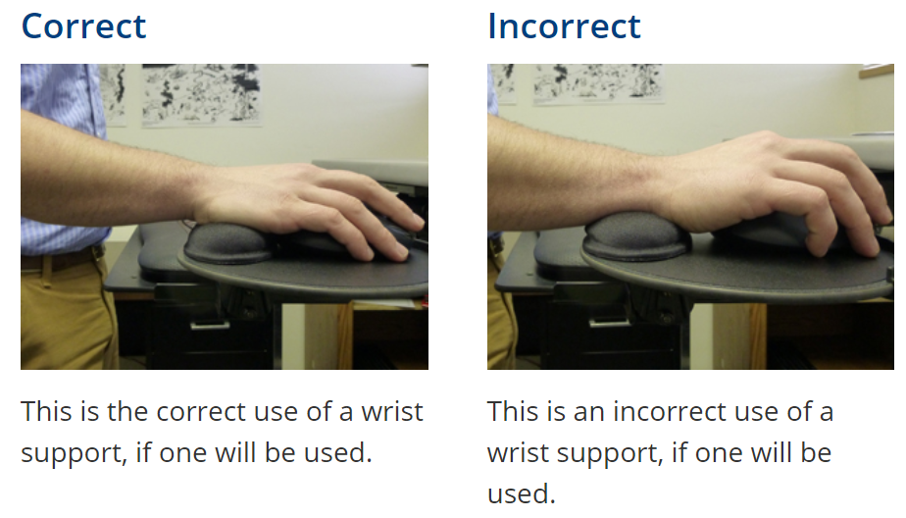
Using Wrist Pads

Slide 19
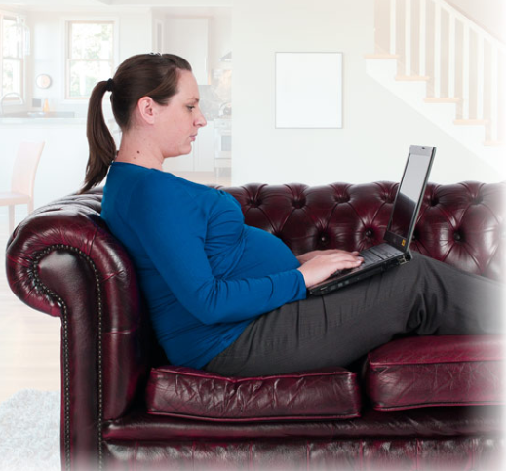
Working from home challenges
Every day we use computers, tablets, smart phones, televisions, and other devices to enhance our work and enrich our lives.
As our reliance on technology increases we need to be aware of a number of factors that can affect us. These include:
Discomfort, possibly from poor posture.
Fatigue, from long working hours at our computers.
Reduced productivity and performance.

Slide 20

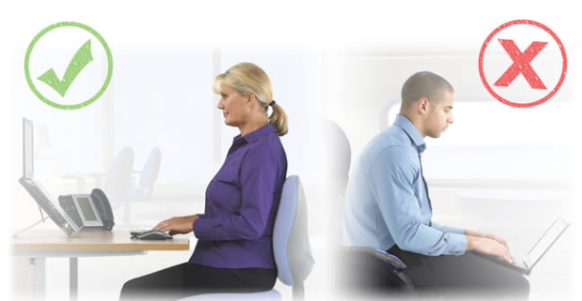
Laptop Use
Placing a laptop on your lap and working doesn’t help to achieve neutral posture as it generally causes the following:
Flexion in the neck to see the screen.
A rounding of the back.
Extension in the wrists while reaching for the keyboard.
Contact points between the laptop and wrists.

Slide 21
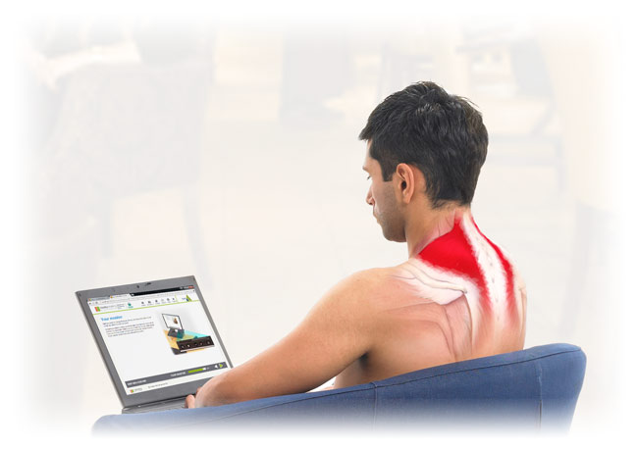
Putting Laptop on knees
If you place your laptop on your knees to work:
The head is tilted downwards towards the laptop.
This will engages a number of muscles
After just a few minutes, your neck muscles will begin to fatigue.
  SOLUTION
Consider using a laptop riser on a work desk
or sitting the laptop on a pile of books so it is at the same height as a regular monitor.
You need a separate keyboard and mouse and ensure the laptop is directly in front of you.

Slide 22
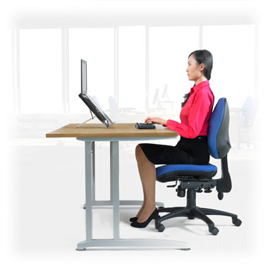
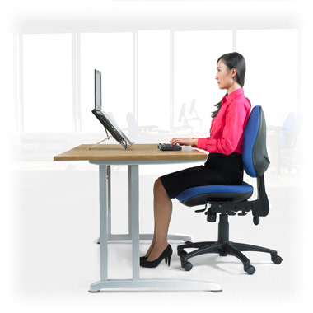
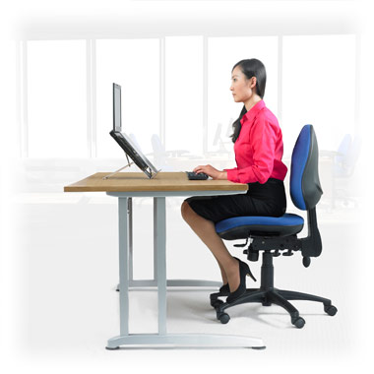

Adjust your height

Slide 23



Adjust your back support

Slide 24



Angle of chair back

Slide 25


Arm rest position

Slide 26

Laptop Monitor
The distance of your screen is also important. If you are able to connect your laptop to a separate screen you should adjust the distance so that is approximately an arm’s length away.
If your monitor is too close your eyes will work harder to focus. If your monitor is too far away you are more likely to lean forward to read the screen which will increase the pressure on your lower back.

Slide 27



Laptop Monitor
A desktop computer screen or separate laptop monitor should be set so the top of your screen is approximately level with your eyes.
If it is too high or too low you will be using your neck and upper back muscles to tilt your head. This will cause fatigue.
If you do not have a separate screen you should stretch regularly and take breaks to avoid long periods of static postures.

Slide 28


Keyboard and Mouse
If you can place your laptop on a table it is advisable to attach a separate keyboard. This will provide you with the flexibility needed to follow best practice principles.
Ideally, your laptop or keyboard should be 10-15cm away from the front of your desk. If it is further away you may lean forward and stretch to reach it.
Avoid working with your laptop or keyboard pushed into the middle of your desk and don’t place paperwork between you and your keyboard.

Slide 29



Reaching
Is your mouse or other input device within easy reach, i.e. next to the keyboard?
Can you move it in all directions? If not, a number of muscles in your upper arm, shoulder, neck and back may be in constant tension, causing fatigue.

Slide 30





Using Mouse
When operating the mouse try to keep your fingers relaxed and avoid curling up or 'hovering' your fingers over the mouse.
When moving the mouse move your arm rather than planting your wrist on the work surface and moving just your hand, as this is a common cause of wrist discomfort.
This is more achievable when sitting at the right distance from the keyboard and mouse and with your upper body supported by the backrest.

Slide 31


Avoiding discomfort
Follow the 20-20-20 Rule
Staring at one point places prolonged stress on the eye muscles, so at least every 20 minutes or so, focus on a distant object (20 feet away) for 20 seconds so that the eye muscles have time to relax and recover.
Remember to blink. It sounds simple but research has shown that computer users tend to blink less when staring at a computer screen (especially if the screen is too close), increasing the likelihood of the eyes becoming dry.

Slide 32



Slide 33


BE SAFE

Slide 36



