Slide 1

Managing Burnout
Zan Barry
Dyan Madrey
October, 25 2021
Notes:
https://www.youtube.com/watch?v=Ylb-B5cKEuU

Slide 2

Working Agreements
Maintain confidentiality, share learning
Take space, make space
Open mind, learning orientation
Listen to each other
Support each other’s growth
Introduce yourself the first time you speak in the large group and when you join a Breakout Room

Slide 3
Objectives:
Define what burnout is
Recognize the signs of burnout
Assess our level of burnout
Mitigate burnout by utilizing MIT resources
Practice burnout relief

Slide 4
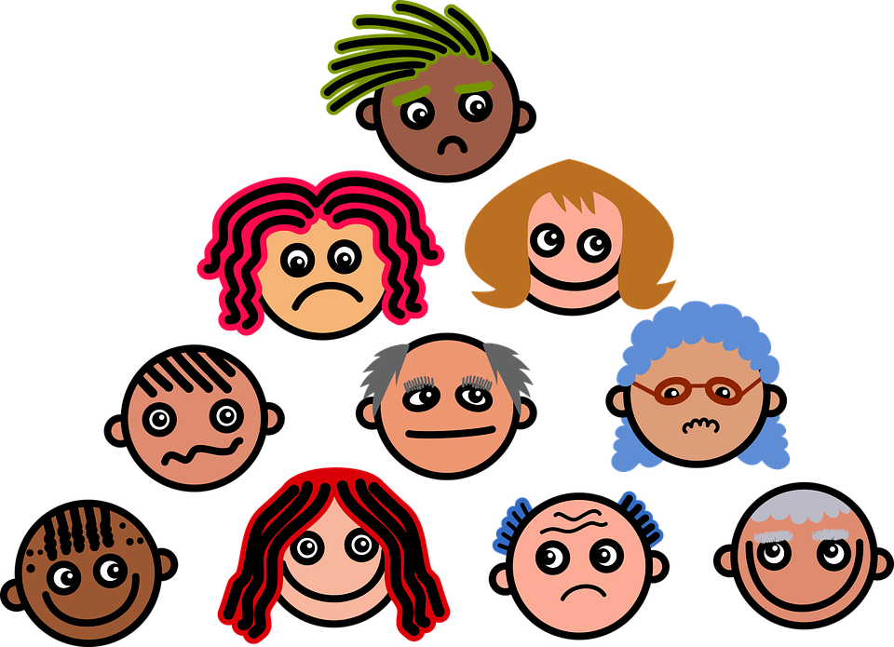
How are you feeling?
https://jamboard.google.com/d/1U9W_seDAyKABNGgO1HlcEkTQI8C2LTm1oBnRyMWguck/viewer

Slide 5

Notes:
30 sec focus breathing. Benefits of breathing.

Slide 6
Benefits of Deep Breathing
Decreases stress by evoking “the relaxation response”
Improves pain tolerance
Helps focus a wandering mind
Increases energy
Lowers blood pressure
https://greatergood.berkeley.edu/article/item/is_the_way_you_breathe_making_you_anxious
https://www.urbanbalance.com/benefits-deep-breathing/

Slide 7
Top Stats and Facts About Employees Burnout
Employees who feel burned out are 63% more likely to take a day off.
Burned-out workers are 2.6 times more prone to look for another job.
23% of employees who burn out at their workplace tend to seek emergency help.
13% of workers are less confident about their performance.
Unconfident workers are 50% less inclined to talk to managers about meeting their performance goals.
https://leftronic.com/employee-burnout-statistics/ Maria Martin 2/21

Slide 8

What is burnout?
Burnout is a reaction to prolonged or chronic job stress and is characterized by three main dimensions:
Exhaustion: physical and emotional
Cynicism (less identification with the job)
Feelings of reduced professional ability
Kathi J. Kemper, MD, MPH of the Ohio State University Wexner Medical Center https://insights.vitalworklife.com/blog/2018/08/13/elements-of-burnout
Image credited to Anna Tarazevich

Slide 9

How it shows up
Dis-engagement or detachment
Depression: helplessness, or hopelessness.
Kathi J. Kemper, MD, MPH of the Ohio State University Wexner Medical Center https://insights.vitalworklife.com/blog/2018/08/13/elements-of-burnout
Image Credit to WellRight

Slide 10

Burnout builds
Burnout can come in waves:
Higher on some days or with certain tasks
Dropping back to manageable levels with recovery time
RECOVERY TIME is essential to prevent chronic burnout
Image credited to Alvesgaspar
Notes:
.

Slide 11
Again, How are you feeling? Breakout room
“I Always Need to be Accessible to my Team.”
“My Employees Are Driving me Crazy.”
“I’m Just Stressed. Period.”
“I Just Don’t Like my Job Anymore.”
Add a statement…
https://www.themuse.com/advice/how-to-deal-with-burnout-as-a-manager
Triads 15 mins/ 5 mins a piece

Slide 12
Burnout Assessment
https://www.surveymonkey.com/r/burnoutmit

Slide 13
Results of assessment
This is a brief, informal assessment. It is not a substitute for clinical advice or formal assessment.
Score 5-10: Manageable stress
Score 11-18: Mid-range stress
Score 19+: High stress
What was it like to assess yourself?

Slide 14
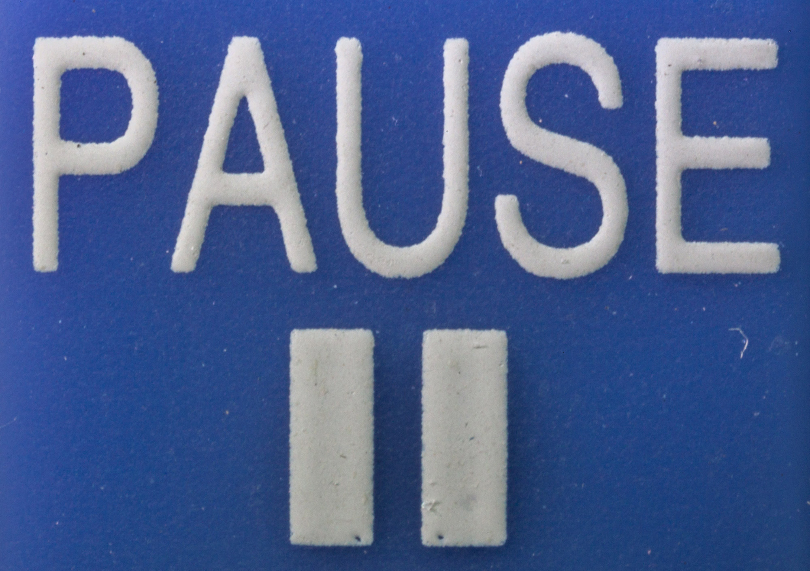
Activity

Slide 15

Self Care

Slide 16
How might you change your mindset and respond differently?
“I always need to be accessible to my team”.
  Try: Taking a (Well-Deserved) Break
“My employees are driving me crazy.”
  Try: Pinpointing the cause
“I’m just stressed. Period.”
  Try: Reevaluating your life outside of work
“I just don’t like my job anymore”
  Try: Remembering why you took the job in the first place
https://www.themuse.com/advice/how-to-deal-with-burnout-as-a-manager

Slide 17
Prioritize YOU
Proper sleep: alertness and ability to react
Healthy body, healthy mind
“To do” list- commit to 3 things and leave room for the unaccepted
Delegate
Try being less reactive
Take care of you

Slide 18
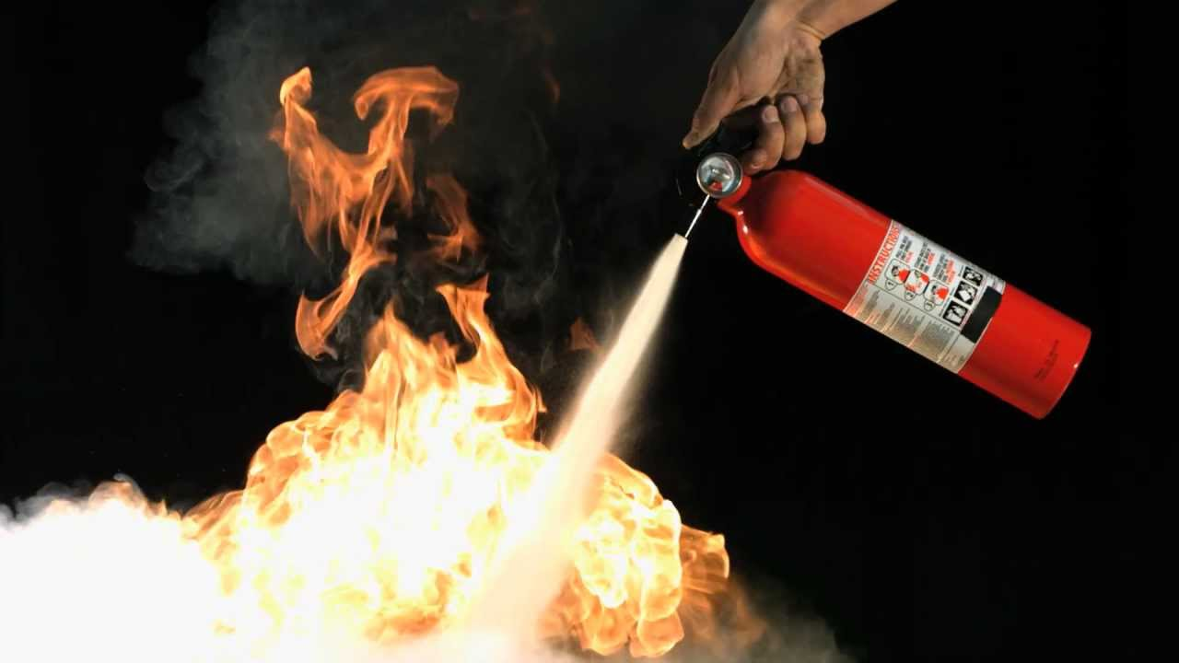
Douse the Flames of Burnout
Delegate a meeting free day of the week
  No meetings on Friday
Are your vacation days adding up
  Take a day off (or more)
  Is your birthday coming up celebrate w/a day off
Create office hours
Schedule “Me” time during the day and after work
  Endicott House virtual (live and recorded) programs https://mitendicotthouse.org/themed-events/
    Cooking
    Gardening
    Virtual events

Slide 19
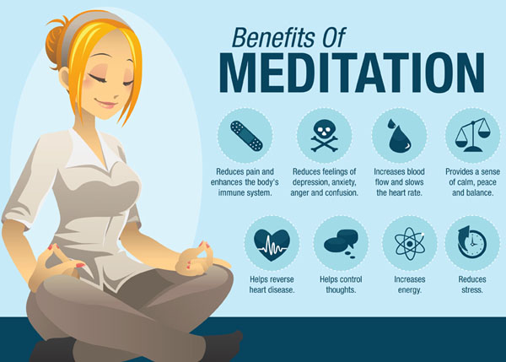

Slide 20
Unwind Classes
Tuesdays and Thursdays 12 and 5 pm EDT
Guided stretch and relaxation
wellness.mit.edu
MIT Sleep and Relaxation Line
617-253-CALM (2256)
3-minute recording
MIT@2:50
at250.mit.edu
10 minutes of daily mindfulness

Slide 21


http://www.mitrecsports.com/ https://medical.mit.edu/community

Slide 22

What are you going to do for you this weekend?

Slide 23
Resources
Brimstone Consulting: Change the upside of the burnout crisis
Getpocket: Key to Better Sleep
How Self Care Can Improve Your Performance as a Leader
Self Care and Support
Avoiding Burnout as a Manager
Stress and Burnout Symptoms and Causes

