Slide 1
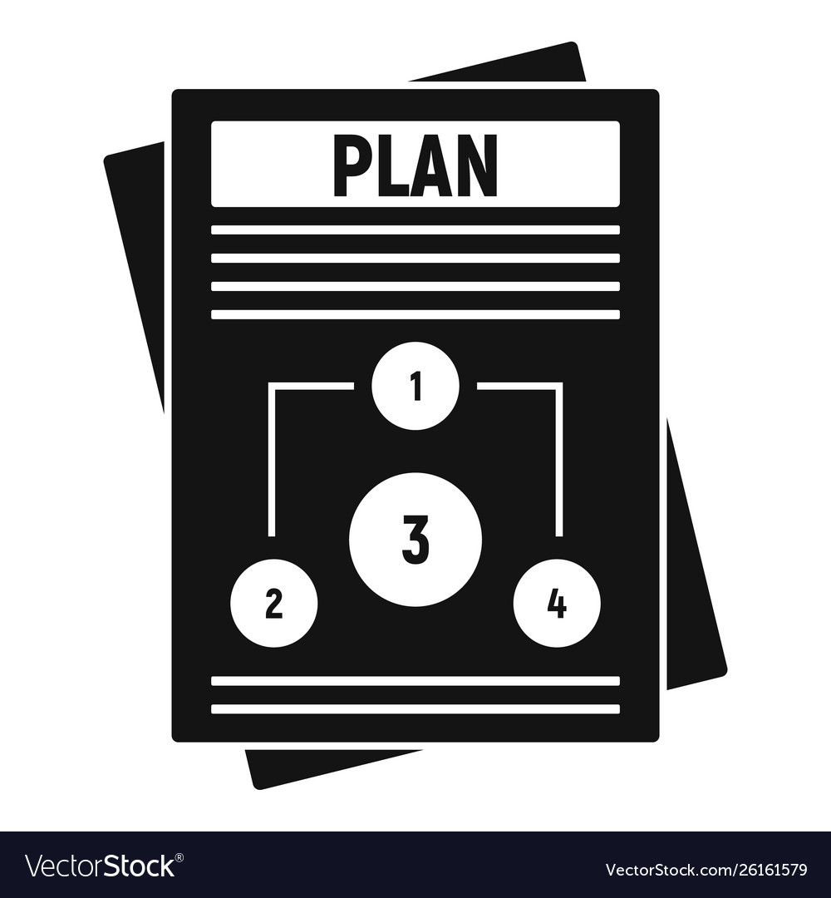
DEI@MIT – Vision
DRAFT
Strategic Action Plan
Network
People
Priorities and Goals
Commitments
Executable and Measurable Tactics, Programs, Initiatives
Institute-wide
Local responsibility and action
Central support and coordination
Individuals, Offices, Groups
Committed to implementing Strategic Action Plan
Synergistic Partnerships
1
Notes:
This presentation is derived from a project planning document that we’ve created to provide some level of project discipline, keep us on-track, and help us to consider and manage potential barriers to the project’s success. As such, we’ve given some thought regarding some of the project risks and invite you to help us consider others that we may not have addressed.
A very broad risk is associated with not getting the project completed. And, it’s our belief that failure to develop and implement an Institute-wide DEI strategic plan will result in the continuation of disconnected and uncoordinated efforts that do not maximize the return on our collective investment in DEI. Without clearly defined goals and metrics, it is hard – at best – to assess the effectiveness of the programs that have been developed to promote inclusion and address compositional diversity.
John and I thought that an important discussion for us today, as we are early in the planning process, is an open discussion about risk. What are the risks to the success of the project, that is, the development of a strategic plan?
Specific risks include those listed on this slide, which we offer as a basis to start the discussion. We would welcome your thoughts on these, and in particular, any other risks that you would identify.
Broad appreciation and value for decentralization and autonomy in how each DLC addresses the needs and concerns of students, postdocs, staff and/or faculty within it;
Being able to come to a consensus regarding our prioritizing of strategic priorities;
Managing the expectations that this 5-year plan will address and resolve all inclusion challenges presented to every underrepresented group;
Access to stakeholders, particularly those who are busier than ever
We’ve been in a virtual world for some time now, and at some point I would anticipate we will be back on campus. The transition between them will also be important to keep in mind.
Faculty (program- and department-level) support and buy-in
Not time-bound
Scale and scope

Slide 2
DEI@MIT – Strategic Priorities
DRAFT
Composition – Improve the relative racial/ethnic and gender representation of our students, staff, postdocs, and faculty. And, create formal mechanisms for expanding the collection of identity data beyond race/ethnicity and gender.
Achievement – Ensure that there is equity for all students, staff, postdocs, and faculty across key measures of success.
Engagement – Promote a learning environment where the understanding and practice of empathy, critical analysis, civil discourse, and inclusion are central to how we create, grow and succeed both as individuals and as an institution.
Inclusion – Create, promote, support and assess a campus climate, culture, or ethos that embodies our Institute values – one where every member of our community feels that they are valued and affirmed.
Achievement
Composition
Inclusion
Engagement
2

Slide 3
DEI@MIT – Risks
DRAFT
Decentralization
Prioritization
Managing expectations
Access to and bandwidth of stakeholders
Stakeholder buy-in
The “new normal”
3
Notes:
This presentation is derived from a project planning document that we’ve created to provide some level of project discipline, keep us on-track, and help us to consider and manage potential barriers to the project’s success. As such, we’ve given some thought regarding some of the project risks and invite you to help us consider others that we may not have addressed.
A very broad risk is associated with not getting the project completed. And, it’s our belief that failure to develop and implement an Institute-wide DEI strategic plan will result in the continuation of disconnected and uncoordinated efforts that do not maximize the return on our collective investment in DEI. Without clearly defined goals and metrics, it is hard – at best – to assess the effectiveness of the programs that have been developed to promote inclusion and address compositional diversity.
John and I thought that an important discussion for us today, as we are early in the planning process, is an open discussion about risk. What are the risks to the success of the project, that is, the development of a strategic plan?
Specific risks include those listed on this slide, which we offer as a basis to start the discussion. We would welcome your thoughts on these, and in particular, any other risks that you would identify.
Broad appreciation and value for decentralization and autonomy in how each DLC addresses the needs and concerns of students, postdocs, staff and/or faculty within it;
Being able to come to a consensus regarding our prioritizing of strategic priorities;
Managing the expectations that this 5-year plan will address and resolve all inclusion challenges presented to every underrepresented group;
Access to stakeholders, particularly those who are busier than ever
We’ve been in a virtual world for some time now, and at some point I would anticipate we will be back on campus. The transition between them will also be important to keep in mind.
Faculty (program- and department-level) support and buy-in
Not time-bound
Scale and scope

Slide 4
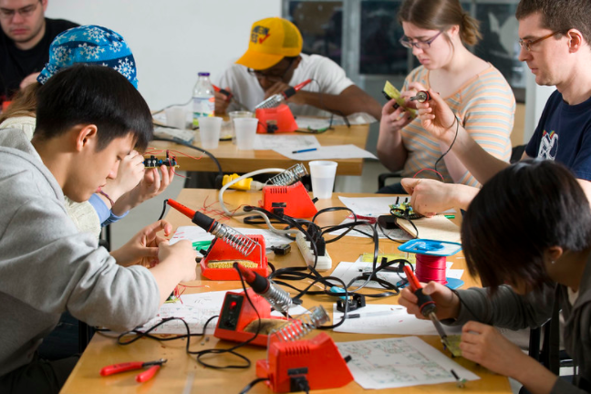
Recommended Activities
DRAFT
We would welcome the opportunity to meet with your communities to discuss the strategic plan and its process.
What are your goals? What would your expectations be for School/College-level and/or Department-level DEI leadership?
How do you envision change happening in your community?
4

Slide 5
Feedback and Suggestions
Tim Jamison
Maryanne Kirkbride
John Dozier
ICEO@mit.edu

